Slide 1
Black Hole Astrophysics Chapters 7.5
All figures extracted from online sources of from the textbook.

Slide 2
Recap – the Schwarzschild metric
“Sch” means that this metric is describing a Schwarzschild Black Hole.
$${\left(g_{SH}^{Sch}\right)}_{αβ}=\left(\begin{matrix}−c^{2}⁢\left(1−\frac{r_{s}}{r}\right) & 0 & 0 & 0 \\ 0 & \frac{1}{\left(1−\frac{r_{s}}{r}\right)} & 0 & 0 \\ 0 & 0 & r^{2} & 0 \\ 0 & 0 & 0 & r^{2}⁢\sin^{2}⁢θ\end{matrix}\right)$$
The Schwarzschild radius $r_{s}=\frac{2⁢GM}{c^{2}}$
“SH” means that we are in the Schwarzschild-Hilbert coordinate system.

Slide 3
Recap – coordinate systems used
1. The moving body frame (MOV)
3. Schwarzschild-Hilbert frame (SH)
2. Fixed local Lorentz frame (FIX)

Slide 4
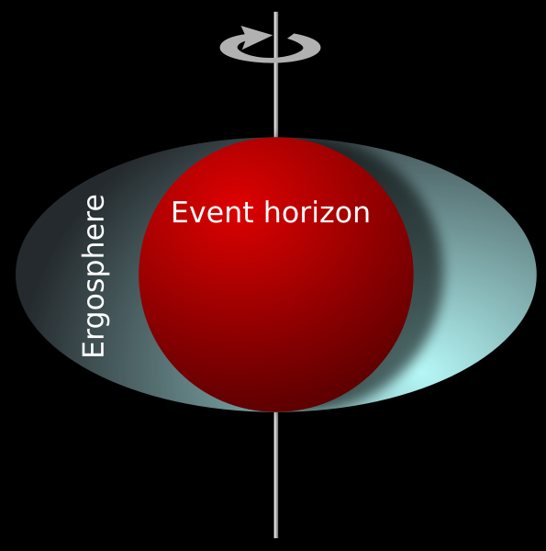
What is a Kerr Black Hole?
Solution to the Einstein Equations for
Rotating, Uncharged, axially-symmetric black hole in empty spacetime.
Brief Introduction:
Like other stars, black holes can rotate. The difference here, is that black hole rotational speeds can be near the speed of light, causing still more changes in the metric and in the way matter moves near a black hole. Space itself around a black hole can rotate, and it is this rotation of space that, very possibly, is the ultimate cause for some of the powerful jets of matter that we see being ejected from quasars and other black hole systems.

Slide 5
The Kerr Metric
“KER” means that this metric is describing a Kerr Black Hole.
$${\left(g_{BL}^{KER}\right)}_{αβ}=\left(\begin{matrix}−\left(1−\frac{2⁢r_{g}⁢r}{ρ^{2}}\right)⁢c^{2} & 0 & 0 & −\frac{{ωΣ}^{2}⁢\sin^{2}⁢θ}{ρ^{2}} \\ 0 & \frac{ρ^{2}}{Δ} & 0 & 0 \\ 0 & 0 & ρ^{2} & 0 \\ −\frac{{ωΣ}^{2}⁢\sin^{2}⁢θ}{ρ^{2}} & 0 & 0 & \frac{Σ^{2}}{ρ^{2}}⁢\sin^{2}⁢θ\end{matrix}\right)$$
“BL” means that we are in the Boyer-Lindquist coordinate system (generalization of Schwarzschild-Hilbert coordinate).
The Gravitational radius $r_{g}=\frac{GM}{c^{2}}$
Because the metric is sort of complicated, so the 3 functions are defined for clarity.

Slide 6
The Kerr Metric
$${\left(g_{BL}^{KER}\right)}_{αβ}=\left(\begin{matrix}−\left(1−\frac{2⁢r_{g}⁢r}{ρ^{2}}\right)⁢c^{2} & 0 & 0 & −\frac{{ωΣ}^{2}⁢\sin^{2}⁢θ}{ρ^{2}} \\ 0 & \frac{ρ^{2}}{Δ} & 0 & 0 \\ 0 & 0 & ρ^{2} & 0 \\ −\frac{{ωΣ}^{2}⁢\sin^{2}⁢θ}{ρ^{2}} & 0 & 0 & \frac{Σ^{2}}{ρ^{2}}⁢\sin^{2}⁢θ\end{matrix}\right)$$
The Gravitational radius $r_{g}=\frac{GM}{c^{2}}$
$ω=\frac{2⁢{r_{g}}^{2}⁢r⁢c}{Σ^{2}}⁢j$ angular frequency of space at different points around the BH.
$j=\frac{J}{G⁢{M^{2}}/c}$ is the dimensionless angular momentum parameter ($−1≤j≤1$) that measures how much angular momentum J the BH has relative to its maximum value.
$ρ≡\sqrt{r^{2}+j^{2}⁢{r_{g}}^{2}⁢\cos^{2}⁢θ}$ is the radial distance like r, but constant $ρ$ are oblate; $\lim_{j→0} ρ=r$
$Σ≡\sqrt{{\left(r^{2}+j^{2}⁢{r_{g}}^{2}\right)}^{2}−j^{2}⁢{r_{g}}^{2}⁢Δ⁢\sin^{2}⁢θ}$ is the equatorial area and $\frac{Σsinθ}{ρ}$ is the cylindrical distance from the rotation axis. $\lim_{j→0}Σ=r^{2}$
$$Δ≡r^{2}−2⁢r_{g}⁢r+{r_{g}}^{2}⁢j^{2};\lim_{j→0}Δ=r^{2}−2⁢r_{g}⁢r$$

Slide 7
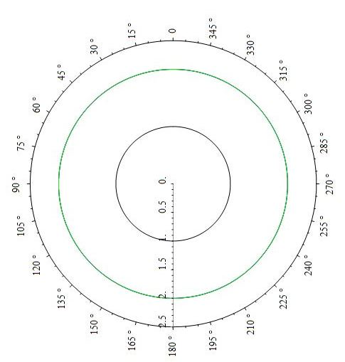
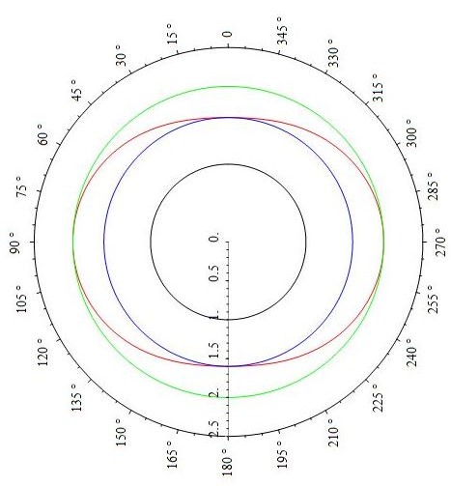
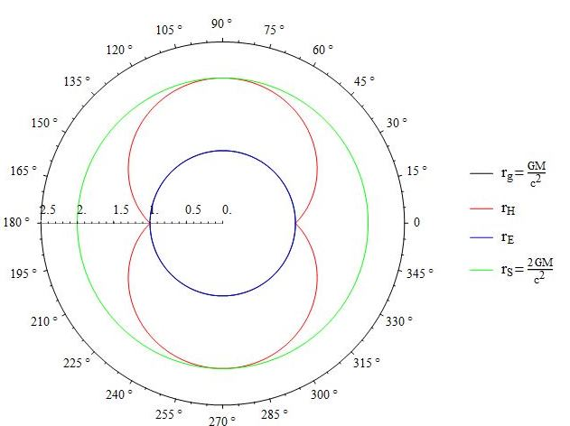
The Horizon and Ergosphere
Previously, with the Schwarzschild BH, both $g_{tt}→0$ and $g_{rr}→∞$at $r=r_{s}$.
$${\left(g_{SH}^{Sch}\right)}_{αβ}=\left(\begin{matrix}−c^{2}⁢\left(1−\frac{r_{s}}{r}\right) & 0 & 0 & 0 \\ 0 & \frac{1}{\left(1−\frac{r_{s}}{r}\right)} & 0 & 0 \\ 0 & 0 & r^{2} & 0 \\ 0 & 0 & 0 & r^{2}⁢\sin^{2}⁢θ\end{matrix}\right)$$
However, for the Kerr metric,
$${\left(g_{BL}^{KER}\right)}_{αβ}=\left(\begin{matrix}−\left(1−\frac{2⁢r_{g}⁢r}{ρ^{2}}\right)⁢c^{2} & 0 & 0 & −\frac{{ωΣ}^{2}⁢\sin^{2}⁢θ}{ρ^{2}} \\ 0 & \frac{ρ^{2}}{Δ} & 0 & 0 \\ 0 & 0 & ρ^{2} & 0 \\ −\frac{{ωΣ}^{2}⁢\sin^{2}⁢θ}{ρ^{2}} & 0 & 0 & \frac{Σ^{2}}{ρ^{2}}⁢\sin^{2}⁢θ\end{matrix}\right)$$
$g_{rr}→∞$ when $Δ→0$ gives $r_{H}=\left(1+\sqrt{1−j^{2}}\right)⁢r_{g}$ which is, in fact, the horizon.
$g_{tt}→0$ when $1−\frac{2⁢r_{g}⁢r}{ρ^{2}}=0$ gives $r_{E}=\left(1+\sqrt{1−j^{2}⁢\cos^{2}⁢θ}\right)⁢r_{g}$
We can see that this is larger than $r_{H}$ except at the poles
j=0
j=0.8
j=1

Slide 8
The Horizon and Ergosphere
$g_{rr}→∞$ when $Δ→0$ gives $r_{H}=\left(1+\sqrt{1−j^{2}}\right)⁢r_{g}$ which is, in fact, the horizon.
$g_{tt}→0$ when $1−\frac{2⁢r_{g}⁢r}{ρ^{2}}=0$ gives $r_{E}=\left(1+\sqrt{1−j^{2}⁢\cos^{2}⁢θ}\right)⁢r_{g}$
So, what happens within $r_{E}$ but outside $r_{H}$?
From the metric,
$${\left(g_{BL}^{KER}\right)}_{αβ}=\left(\begin{matrix}−\left(1−\frac{2⁢r_{g}⁢r}{ρ^{2}}\right)⁢c^{2} & 0 & 0 & −\frac{{ωΣ}^{2}⁢\sin^{2}⁢θ}{ρ^{2}} \\ 0 & \frac{ρ^{2}}{Δ} & 0 & 0 \\ 0 & 0 & ρ^{2} & 0 \\ −\frac{{ωΣ}^{2}⁢\sin^{2}⁢θ}{ρ^{2}} & 0 & 0 & \frac{Σ^{2}}{ρ^{2}}⁢\sin^{2}⁢θ\end{matrix}\right)$$
Both $g_{tt}$ and $g_{rr}$are positive! How will particles behave in this region?
Since particles follow timelike geodesics, ${ds}^{2}<0$, this means that we must have the $g_{tϕ}$ term to be positive. This forces $dϕ$ to be non-zero!
i.e. In this region, called the “Ergosphere”, everything must rotate in the same direction (how to prove?) as the black hole!

Slide 9
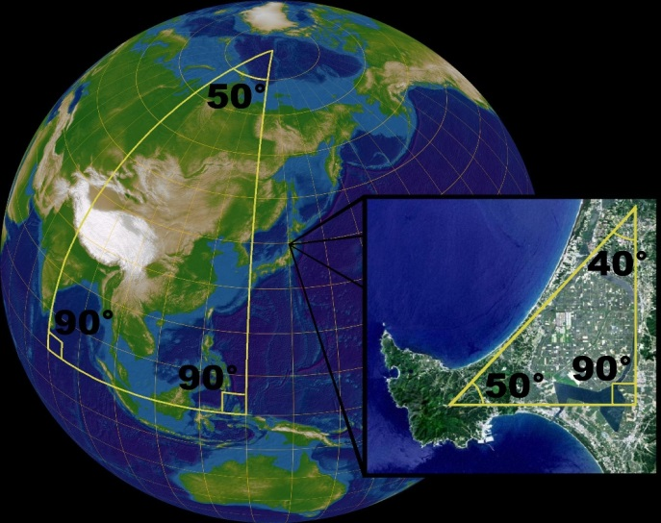
Coordinate systems for Kerr BH
1. The moving body frame (MOV)
3. Boyer-Lindquist frame (BL)
4. Observer at Infinity/Synchronous frame (OIS)
2. Fixed local Lorentz frame (FIX)

Slide 10
The moving body frame (MOV)
Similar to the Schwarzschild BH case, we can choose to move with the object of interest. Since spacetime is locally flat, we have a Minkowski metric in this case
$${\left(g_{MOV}^{KER}\right)}_{αβ}=\left(\begin{matrix}−1 & 0 & 0 & 0 \\ 0 & 1 & 0 & 0 \\ 0 & 0 & 1 & 0 \\ 0 & 0 & 0 & 1\end{matrix}\right)$$
and by definition the 4-velocity ${\left(U_{MOV}\right)}^{α}=\left(c,0,0,0\right)$

Slide 11
Fixed local Lorentz frame (FIX)
Again, we consider some locally flat part of the Kerr spacetime to sit on and watch things fly past. Therefore the metric is still the Minkowski one
$${\left(g_{FIX}^{KER}\right)}_{αβ}=\left(\begin{matrix}−1 & 0 & 0 & 0 \\ 0 & 1 & 0 & 0 \\ 0 & 0 & 1 & 0 \\ 0 & 0 & 0 & 1\end{matrix}\right)$$
but now the 4-velocity of objects become
$${\left(U_{FIX}\right)}^{α}=\left(\begin{matrix}γc \\ {γV}^{\hat{r}} \\ {γV}^{\hat{θ}} \\ {γV}^{\hat{φ}}\end{matrix}\right)$$
However, the Kerr spacetime itself is rotating, therefore being fixed in such a frame means that you are actually rotating with the black hole at rate $ω$.
Therefore this observer has no angular momentum with respect to the BH.

Slide 12
Boyer-Lindquist frame (BL)
This is a global coordinate, just like the SH frame used for Schwarzschild BH.
For this coordinate, the metric is the one we presented earlier
$${\left(g_{BL}^{KER}\right)}_{αβ}=\left(\begin{matrix}−\left(1−\frac{2⁢r_{g}⁢r}{ρ^{2}}\right)⁢c^{2} & 0 & 0 & −\frac{{ωΣ}^{2}⁢\sin^{2}⁢θ}{ρ^{2}} \\ 0 & \frac{ρ^{2}}{Δ} & 0 & 0 \\ 0 & 0 & ρ^{2} & 0 \\ −\frac{{ωΣ}^{2}⁢\sin^{2}⁢θ}{ρ^{2}} & 0 & 0 & \frac{Σ^{2}}{ρ^{2}}⁢\sin^{2}⁢θ\end{matrix}\right)$$

Slide 13
Observer at Infinity/Synchronous frame (OIS)
This system rotates with the space around the black hole, is local to each radius r, and has a diagonal metric; but that metric is not an orthonormal Lorentz/ Minkowskian system . It relates to the BL coordinates simply by $dϕ′=dϕ−ωdt$
$$Λ_{BL}^{OIS}=\left(\begin{matrix}1 & 0 & 0 & 0 \\ 0 & 1 & 0 & 0 \\ 0 & 0 & 1 & 0 \\ −ω & 0 & 0 & 1\end{matrix}\right)$$
Which give the metric
$${\left(g_{OIS}^{KER}\right)}_{αβ}=\left(\begin{matrix}−\frac{ρ^{2}Δ}{Σ^{2}}⁢c^{2} & 0 & 0 & 0 \\ 0 & \frac{ρ^{2}}{Δ} & 0 & 0 \\ 0 & 0 & ρ^{2} & 0 \\ 0 & 0 & 0 & \frac{Σ^{2}}{ρ^{2}}⁢\sin^{2}⁢θ\end{matrix}\right)$$
Following same procedure as last week (see p12 of last week)
$${\left(U_{OIS}\right)}^{α}=Λ_{FIX}^{OIS}⁢{\left(U_{FIX}\right)}^{α}=\left(\begin{matrix}\frac{Σ}{ρc⁢\sqrt{Δ}} & 0 & 0 & 0 \\ 0 & \frac{\sqrt{Δ}}{ρ} & 0 & 0 \\ 0 & 0 & \frac{1}{ρ} & 0 \\ 0 & 0 & 0 & \frac{ρ}{Σ⁢sinθ}\end{matrix}\right)⁢\left(\begin{matrix}γc \\ {γV}^{\hat{r}} \\ {γV}^{\hat{θ}} \\ {γV}^{\hat{φ}}\end{matrix}\right)=\left(\begin{matrix}{γΣ}/ρ⁢\sqrt{Δ} \\ {γV}^{\hat{r}}⁢{\sqrt{Δ}}/ρ \\ {{γV}^{\hat{θ}}}/ρ \\ {γV}^{\hat{φ}}⁢ρ/Σ⁢sinθ\end{matrix}\right)$$

Slide 14
Back to the Boyer-Lindquist frame
4. Observer at Infinity/ Synchronous frame (OIS)
3. Boyer-Lindquist frame (BL)
The OIS is not a good system in which to work. It is not global, so derivatives are valid only locally. And the ergosphere is hidden in this frame because ω is gone from $g_{OIS}^{KER}.$ So we quickly leave the OIS system and transform the vectors and 1-forms back to the Kerr system to ﬁnd
$${\left(U_{BL}\right)}^{α}=Λ_{OIS}^{BL}⁢{\left(U_{OIS}\right)}^{α}=\left(\begin{matrix}{γΣ}/ρ⁢\sqrt{Δ} \\ {γV}^{\hat{r}}⁢{\sqrt{Δ}}/ρ \\ {{γV}^{\hat{θ}}}/ρ \\ \frac{{γV}^{\hat{φ}}⁢ρ}{Σsinθ}+\frac{γΣω}{ρ⁢\sqrt{Δ}}\end{matrix}\right)$$
$${\left(u^{BL}\right)}_{α}=\left(−\left[{γc}^{2}⁢\frac{ρ⁢\sqrt{Δ}}{Σ}+\frac{{γV}^{\hat{φ}}⁢Σsinθ}{ρ}⁢ω\right],\frac{{γρV}^{\hat{r}}}{\sqrt{Δ}},{γρV}^{\hat{θ}},\frac{γΣsinθ}{ρ}⁢V^{\hat{φ}}\right)$$
Remember that $\left(V^{\hat{r}},V^{\hat{θ}},V^{\hat{φ}}\right)$ are all evaluated in the FIX frame.

Slide 15
Conserved Quantities
As we have introduced last week, since the metric is independent of t and $φ$, Energy and angular momentum are conserved.
The Angular momentum:
$$L=p_{φ}^{Kerr}=γm_{0}V^{\hat{φ}}\frac{Σsinθ}{ρ}⁢$$
$$\frac{{dp}_{φ}}{dτ}≡\frac{dL}{dτ}=0$$
$$p_{φ}^{Schwarzschild}=γ⁢m_{0}⁢V^{\hat{φ}}⁢r⁢sinθ$$
Comparing with the Schwarzschild case, it’s easy to see that $\frac{Σsinθ}{ρ}⁢$is the cylindrical radius as we mentioned before.

Slide 16
Conserved Quantities
Energy:
$$E^{Schwarzschild}=−p_{t}=γ⁢m_{0}⁢c^{2}\sqrt{1−\frac{r_{s}}{r}}⁢$$
$$\frac{{dp}_{t}}{dτ}≡−\frac{dE}{dτ}=0$$
$$E^{Kerr}=−p_{t}=γm_{0}c^{2}⁢\frac{ρ⁢\sqrt{Δ}}{Σ}+{γm_{0}V}^{\hat{φ}}\frac{⁢Σsinθ}{ρ}⁢ω$$
Energy at infinity
${γm_{0}V}^{\hat{φ}}\frac{⁢Σsinθ}{ρ}⁢ω$
Is the new term in Kerr metric due to rotation of space.
If $V^{\hat{φ}}>0$ the particle is rotating in the same direction as the BH, and we see that it adds to the energy at infinity.
If $V^{\hat{φ}}<0$ the particle rotates in the opposite direction as the BH, now, it subtracts from the energy at infinity!
However, as long as $E^{Kerr}>0$ the particle will always add mass to the BH.

Slide 17
Negative energy
For a Kerr BH, there are two terms as we have discussed, therefore it is now possible to have negative energy!
$$E^{Kerr}=−p_{t}=γm_{0}c^{2}⁢\frac{ρ⁢\sqrt{Δ}}{Σ}+{γm_{0}V}^{\hat{φ}}\frac{⁢Σsinθ}{ρ}⁢ω$$
We find that to achieve this, the condition is $\frac{V^{\hat{φ}}}{c}>\frac{ρ^{2}⁢\sqrt{Δ}}{Σ^{2}⁢sinθ}⁢\frac{c}{ω}=\frac{ρ^{2}⁢\sqrt{Δ}}{2⁢{{jr}_{g}}^{2}⁢r⁢sinθ}$
Energy is now negative and this particle will actually decrease the BH mass as it falls in! This also means that in the process, it releases part of the BH mass as energy to the outside world!
However, we find that since $V^{\hat{φ}}<c$ always, the only place where this condition can hold is within the ergosphere.
This process of extracting rotational mass-energy from the BH is called the Penrose Process.

Slide 18
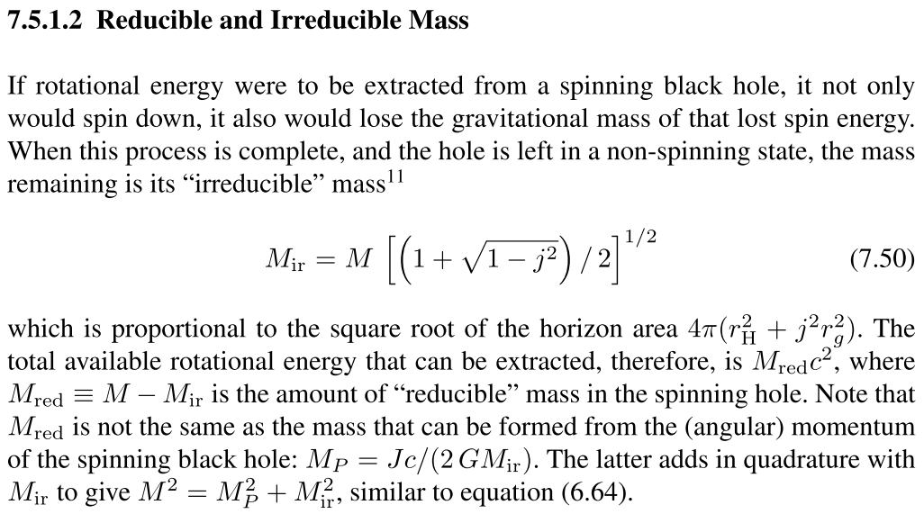
Reducible and irreducible mass
The Gravitational radius $r_{g}=\frac{2⁢GM}{c^{2}}$
If rotational energy were to be extracted from a spinning black hole, it not only
would spin down, it also would lose the gravitational mass of that lost spin energy.
When this process is complete, and the hole is left in a non-spinning state, the mass
remaining is its “irreducible” mass $M_{ir}=M⁢\sqrt{\frac{1+\sqrt{1−j^{2}}}{2}}$
Not done

Slide 19
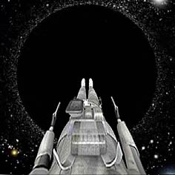
Free fall
$$L=γm_{0}V^{\hat{φ}}\frac{Σsinθ}{ρ}⁢$$
The free fall case is easy to compute, since it will have $V^{\hat{φ}}=0$ always.
This is in fact very interesting because $V^{\hat{φ}}$ is relative to the rotating space around the Kerr BH! So, the falling body actually picks up angular velocity that is exactly that of the rotating space!
$v^{φ}=\frac{U^{\hat{φ}}}{U^{\hat{t}}}=\frac{\frac{{γV}^{\hat{φ}}⁢ρ}{Σsinθ}+\frac{γΣω}{ρ⁢\sqrt{Δ}}}{{γΣ}/ρ⁢\sqrt{Δ}}=ω!$
$v^{φ}$is the velocity measured by an observer using the BL frame.

Slide 20
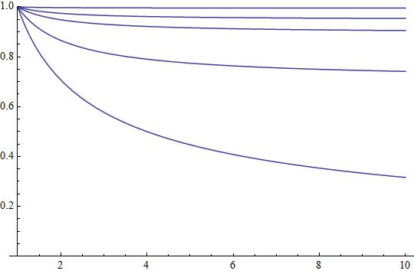
Free fall
Now, let’s discuss the detailed velocity as a function of r as the particle falls from infinity.
By setting the energy at infinity to the rest mass-energy as we did last week,
$$E⁢\left(r\right)=m_{0}⁢\left({γc}^{2}⁢\frac{ρ⁢\sqrt{Δ}}{Σ}+\frac{{γV}^{\hat{φ}}⁢Σsinθ}{ρ}⁢ω\right)=E_{∞}=m_{0}⁢c^{2}$$
Schwarzschild case:
We find
$${V^{\hat{r}}}_{ff,SH}(r)=−c\sqrt{\frac{2⁢r_{g}}{r}}$$
$$V_{ff,BL}^{\hat{r}}⁢\left(r,j\right)=−c⁢\sqrt{\frac{2⁢r_{g}}{r}}⁢\left(\frac{r⁢\sqrt{r^{2}+j^{2}⁢{r_{g}}^{2}}}{Σ}\right)$$
$$E_{∞}=100m_{0}⁢c^{2}$$
$$E_{∞}=10m_{0}⁢c^{2}$$
$$E_{∞}=5m_{0}⁢c^{2}$$
$$Σ≡\sqrt{{\left(r^{2}+j^{2}⁢{r_{g}}^{2}\right)}^{2}−j^{2}⁢{r_{g}}^{2}⁢Δ⁢\sin^{2}⁢θ}$$
$$E_{∞}=2m_{0}⁢c^{2}$$
$$Δ≡r^{2}−2⁢r_{g}⁢r+{r_{g}}^{2}⁢j^{2}$$
$$E_{∞}=m_{0}⁢c^{2}$$
For the Kerr case , even a simple free-fall becomes very interesting, it depends on not only the spin but also the angle of entry $θ$.
Let’s plot some of these on the next page and see what happens.

Slide 21
Free fall
Mathematica file

Slide 22
Orbits in the equatorial plane
Following a similar procedure as the Schwarzschild case, but much more complicated (I don’t know exactly how complicated it is because I didn’t do it…), we get
Schwarzschild case:
$$\frac{V_{orb,BL}^{\hat{φ}}}{c}=\frac{Σ^{2}}{\sqrt{Δ}⁢\left(r^{3}−j^{2}⁢{r_{g}}^{3}\right)}⁢\left(±\sqrt{\frac{r_{g}}{r}}−j⁢\frac{{r_{g}}^{2}}{r^{2}}\right)−\frac{2⁢j⁢{r_{g}}^{2}}{r⁢\sqrt{Δ}}$$
$$\frac{V_{orb,SH}^{\hat{φ}}}{c}=\sqrt{\frac{r_{g}}{r−2⁢r_{g}}}$$
$$±\sqrt{\frac{r_{g}}{r}}$$
Keplerian rotation in the rotating space of the BH.
$+⁢$ is prograde (in the global coordinate)
$−$ is retrograde (in the global coordinate)
$$−j⁢\frac{{r_{g}}^{2}}{r^{2}}$$
Comes from the outward contrifugal effect due to rotation of space.
$$−\frac{2⁢j⁢{r_{g}}^{2}}{r⁢\sqrt{Δ}}$$
Because we measure $V_{orb,BL}^{\hat{φ}}$ in the rotating frame, so the velocity of the metric must be subtracted off.

Slide 23
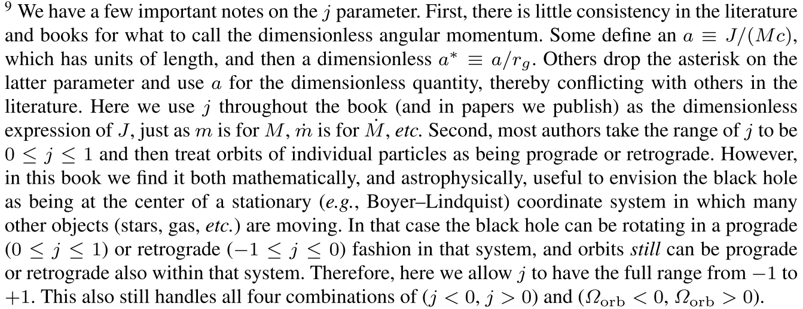
A note on prograde and retrograde
$j=\frac{J}{G⁢{M^{2}}/c}$ is the dimensionless angular momentum parameter ($−1≤j≤1$) that measures how much angular momentum J the BH has relative to its maximum value.
$$±\sqrt{\frac{r_{g}}{r}}$$
Keplerian rotation in the rotating space of the BH.
$+⁢$ is prograde (in the global coordinate)
$−$ is retrograde (in the global coordinate)

Slide 24
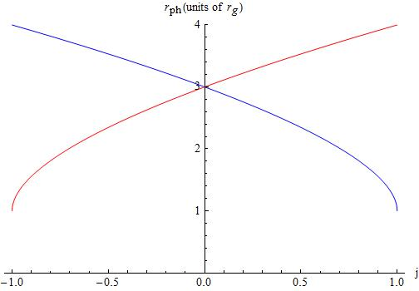
The photon orbit
$$r_{ph,BL}=2⁢r_{g}⁢\left(1+cos⁢\left(\frac{2}{3}⁢\cos^{−1}⁢\left(∓j\right)\right)\right)$$
Using $V_{orb,BL}^{\hat{φ}}=c$ as last week,
Orbiting counter to BH spin.
Prograde orbit in j=-1 BH is further from the BH (4 $⁢r_{g}$) because it is going against the BH.
Retrograde orbit in j=1 BH is further from the BH (4 $⁢r_{g}$) because it is going against the BH.
Schwarzschild case
retrograde
prograde
Retrograde orbit in j=-1 BH gets close to the BH (1 $⁢r_{g}$) because it is also going in the same direction as the BH.
Prograde orbit in j=1 BH gets close to the BH (1 $⁢r_{g}$) because it is going in the same direction as the BH.
Orbiting in same direction as BH spin.

Slide 25
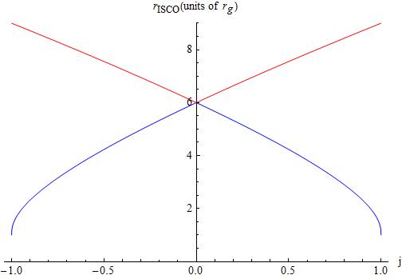
The ISCO
Following similar but more complicated derivation as last week (again, I was lazy),
$$r_{ISCO,BL}=h∓\sqrt{\frac{−h^{3}+9⁢h^{2}−3⁢\left(6−j^{2}\right)⁢h+7⁢j^{2}}{h−3}}$$
Retrograde orbit in j=1 BH is further from the BH (9 $⁢r_{g}$) because it is going against the BH.
$$h=3+\sqrt{3+j^{2}+{\left(1−j^{2}\right)}^{\frac{1}{3}}⁢\left(\left(3−j\right)⁢{\left(1+j\right)}^{\frac{1}{3}}+\left(3+j\right)⁢{\left(1−j\right)}^{\frac{1}{3}}\right)}$$
Prograde orbit in j=1 BH gets close to the BH (1 $⁢r_{g}$) because it is going in the same direction as the BH.
What happened here??
Schwarzschild case
retrograde
prograde

Slide 26
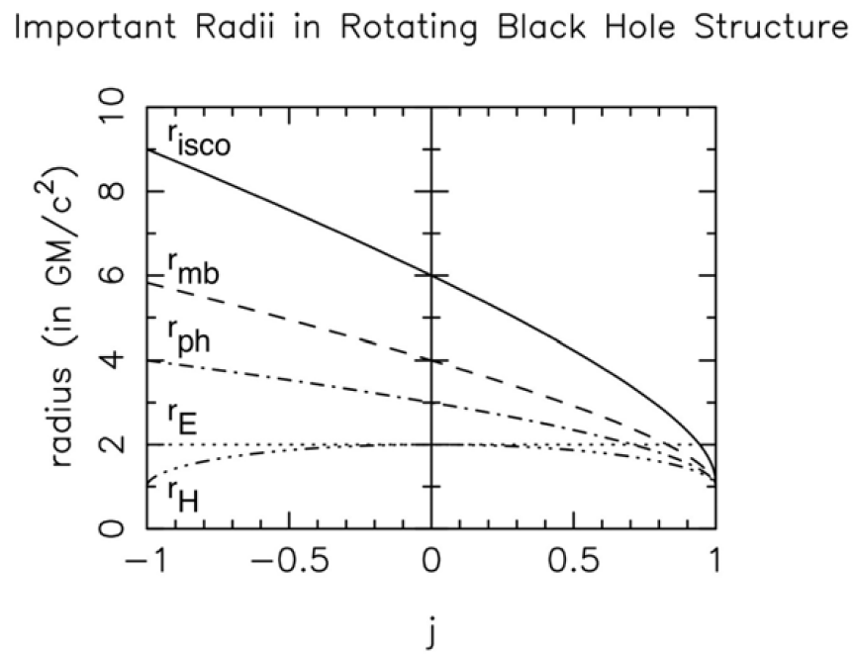
Prograde orbits

Slide 27
Horizon Penetrating Coordinates
$${\left(g_{BL}^{KER}\right)}_{αβ}=\left(\begin{matrix}−\left(1−\frac{2⁢r_{g}⁢r}{ρ^{2}}\right)⁢c^{2} & 0 & 0 & −\frac{{ωΣ}^{2}⁢\sin^{2}⁢θ}{ρ^{2}} \\ 0 & \frac{ρ^{2}}{Δ} & 0 & 0 \\ 0 & 0 & ρ^{2} & 0 \\ −\frac{{ωΣ}^{2}⁢\sin^{2}⁢θ}{ρ^{2}} & 0 & 0 & \frac{Σ^{2}}{ρ^{2}}⁢\sin^{2}⁢θ\end{matrix}\right)$$
As can be seen from the BL coordinates, the singularity in $g_{rr}$ comes with$Δ→0$. To avoid this, we can again find a horizon penetrating coordinate similar to what we have done in the Schwarzschild BH case.
This is achieved by redefining both t and $ϕ$
$$dt=dt′−\frac{2⁢r_{g}⁢r}{cΔ}⁢dr$$
$$dϕ=dϕ′−\frac{{jr}_{g}}{Δ}⁢dr$$
The coordinate change compresses time near the BH.
Then the new metric reads
$${\left(g_{HP}^{KER}\right)}_{αβ}≡\left(\begin{matrix}−\left(1−\frac{2⁢r_{g}⁢r}{ρ^{2}}\right)⁢c^{2} & \frac{2⁢r_{g}⁢r}{ρ^{2}}⁢c & 0 & −\frac{{ωΣ}^{2}⁢\sin^{2}⁢θ}{ρ^{2}} \\ \frac{2⁢r_{g}⁢r}{ρ^{2}}⁢c & 1+\frac{2⁢r_{g}⁢r}{ρ^{2}} & 0 & −{jr}_{g}⁢\sin^{2}⁢θ⁢\left(1+\frac{2⁢r_{g}⁢r}{ρ^{2}}\right) \\ 0 & 0 & ρ^{2} & 0 \\ −\frac{{ωΣ}^{2}⁢\sin^{2}⁢θ}{ρ^{2}} & −{jr}_{g}⁢\sin^{2}⁢θ⁢\left(1+\frac{2⁢r_{g}⁢r}{ρ^{2}}\right) & 0 & \frac{Σ^{2}}{ρ^{2}}⁢\sin^{2}⁢θ\end{matrix}\right)$$

